Slide 1

2020 General Election Analysis
By: Megann Bohlken, Emily Edwards, Olivia Hawkins, Megan Leiding

Slide 2
Research Question
Are the election polls accurate predictors of the final vote?
Polling data from October 28th and November 2nd
Second presidential debate held on October 22nd
Election Day November 3rd
Final vote updated on Sunday, December 6th
Data from Fivethirtyeight GitHub repository
INTRODUCTION | SCENARIOS I STATE | EC | NATIONAL | CONCLUSION​

Slide 3
Scenario Analysis
The results of the analysis are presented as probabilities based on polling results
Data goes back to June 1, 2020
4,000 simulations for each scenario every day
INTRODUCTION | SCENARIOS I STATE | EC | NATIONAL | CONCLUSION​​

Slide 4
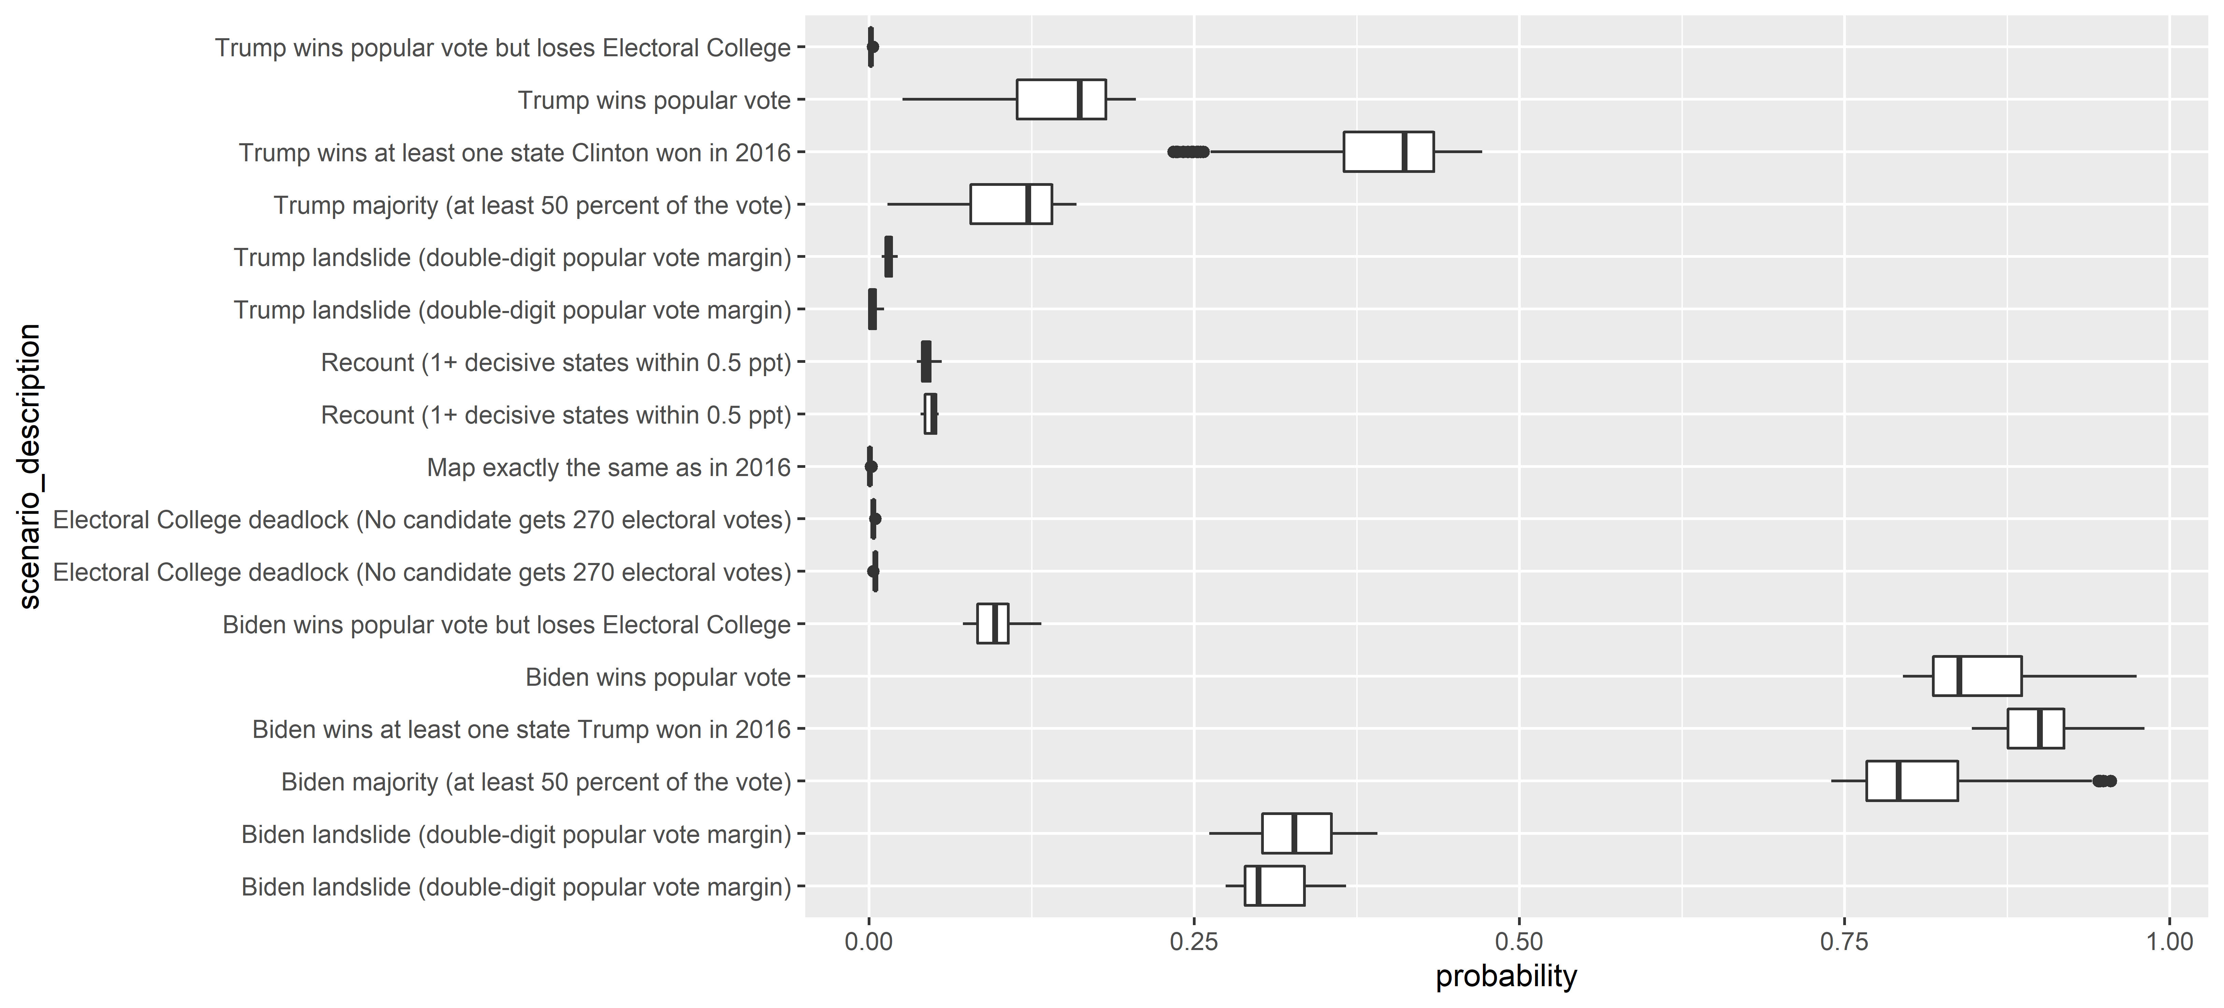
Popular Vote
14.1%
85.9%
INTRODUCTION | SCENARIOS I STATE | EC | NATIONAL | CONCLUSION​​

Slide 5
State Flipping
38.5%
90.3%
INTRODUCTION | SCENARIOS I STATE | EC | NATIONAL | CONCLUSION​​

Slide 6
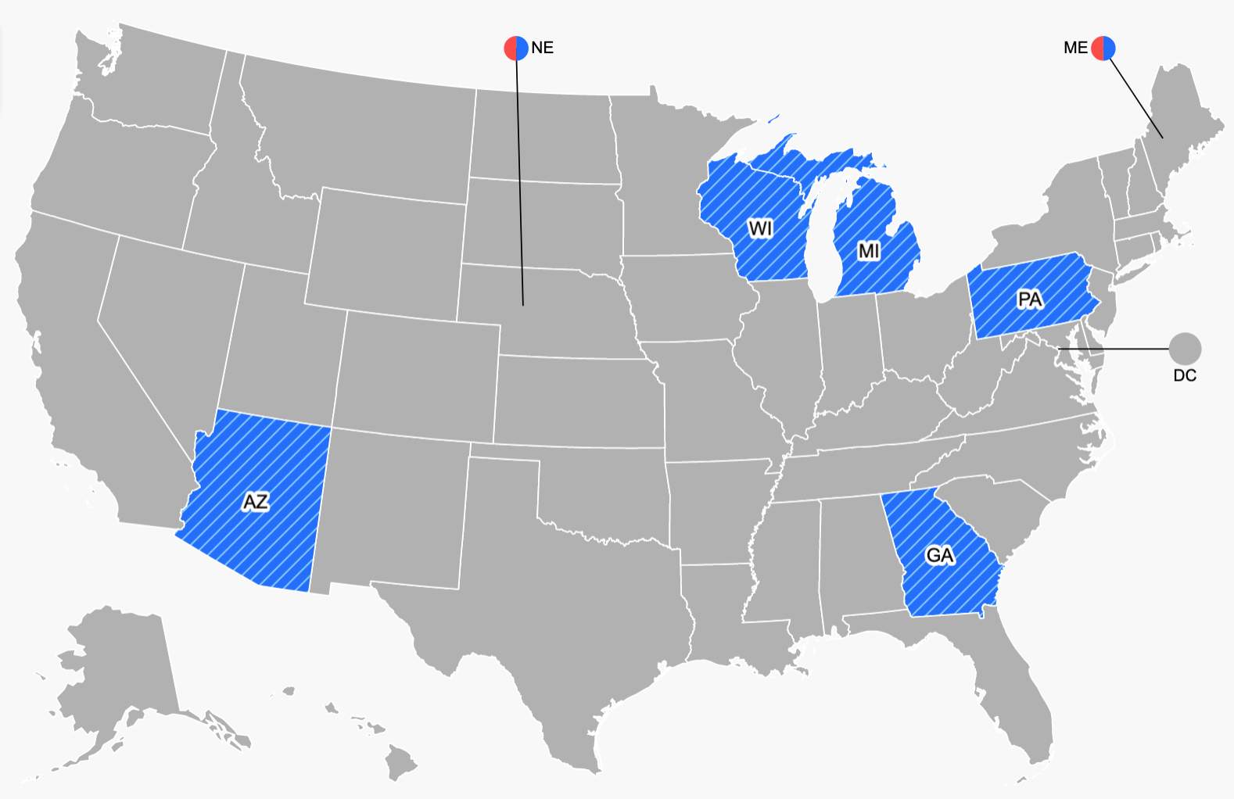
Flipped States
Only five states were flipped during the 2020 election
Biden flipped Arizona, *Wisconsin, *Michigan, *Pennsylvania, and Georgia
Trump did not flip any states
Map from CNN President Results
INTRODUCTION | SCENARIOS I STATE | EC | NATIONAL | CONCLUSION​​

Slide 7
Low Probability Cases
INTRODUCTION | SCENARIOS I STATE | EC | NATIONAL | CONCLUSION​​

Slide 8
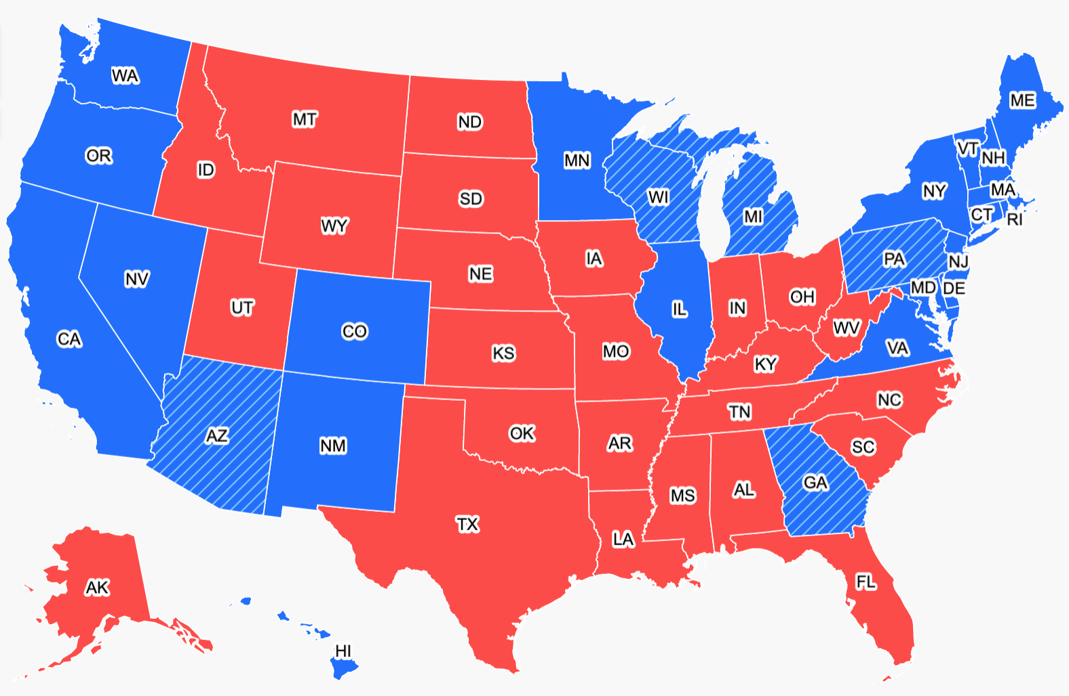
50 State Analysis
50 states plus District of Columbia
Consolidated
Maine from 2 districts
Nebraska from 3 districts
Map from CNN President Results
INTRODUCTION | SCENARIOS I STATE | EC | NATIONAL | CONCLUSION​​
Notes:
https://www.cnn.com/election/2020/results/president

Slide 9
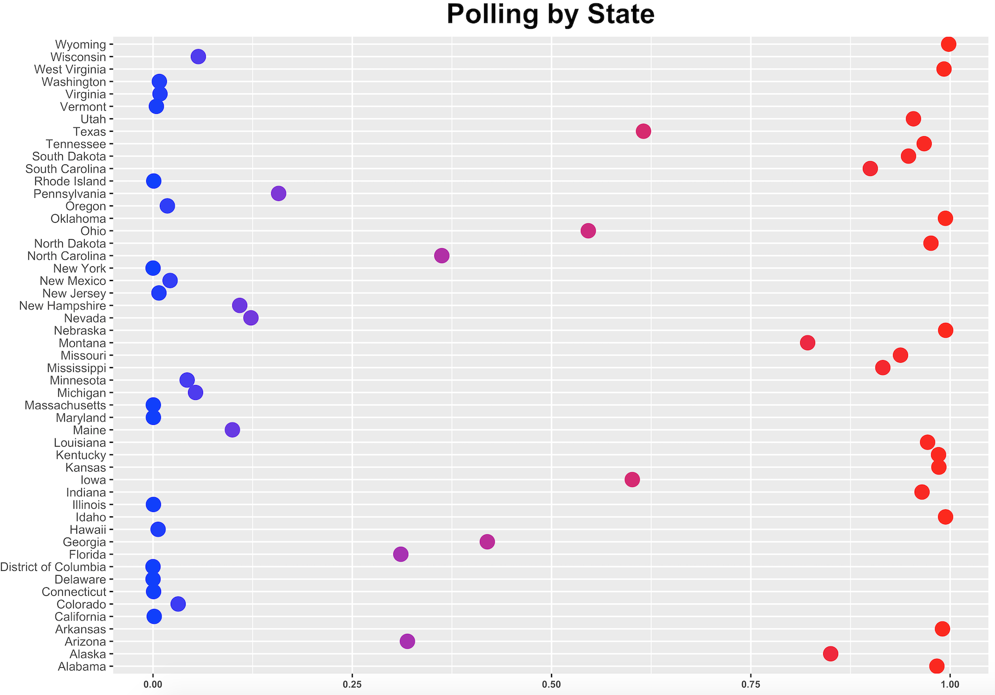


Final Vote:
Biden wins
80,992,666 votes counted
Biden won 25/50 states

Slide 10
Swing State Analysis
Swing states hold equal support for each party
Often used as predictors for national outcome
"Big Four" are Florida, Michigan, Pennsylvania and Wisconsin
And Iowa :)
INTRODUCTION | SCENARIOS | STATE | EC | NATIONAL | CONCLUSION​​
Notes:
So now I'm going to dial down into
Wikipedia
Arizona and Georgia were also states watched closely this past election

Slide 11
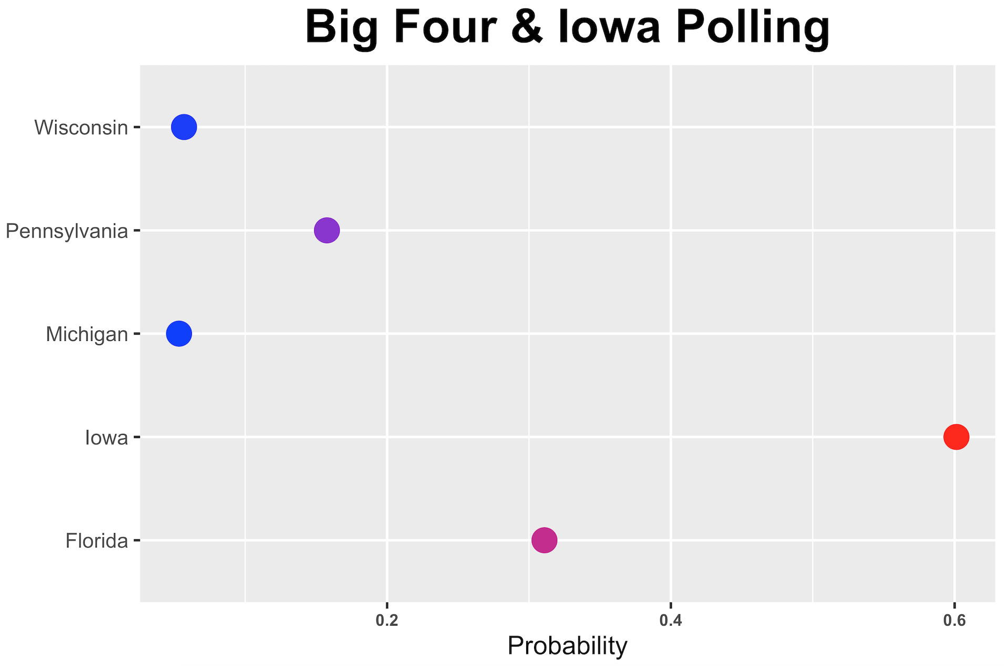
Swing State Analysis
Final Vote Results
Wisconsin
Pennsylvania
Michigan
Iowa
Florida
INTRODUCTION | SCENARIOS I STATE | EC | NATIONAL | CONCLUSION​​
Notes:
We graphed the predicitions for these 5 states
our analysis we
Of these four swing states, Biden successfully flipped Wisconsin, Michigan, Pennsylvania. Meaning that these states voted red in 2016 and voted blue in most recent election
Wisconsin 49.4 %
Penn. 50.0 %
Michigan 50.6%
Iowa 52.2 %
Florida 51.2 %
https://www.cnn.com/interactive/2020/11/politics/2020-vs-2016-election-map-charts/

Slide 12
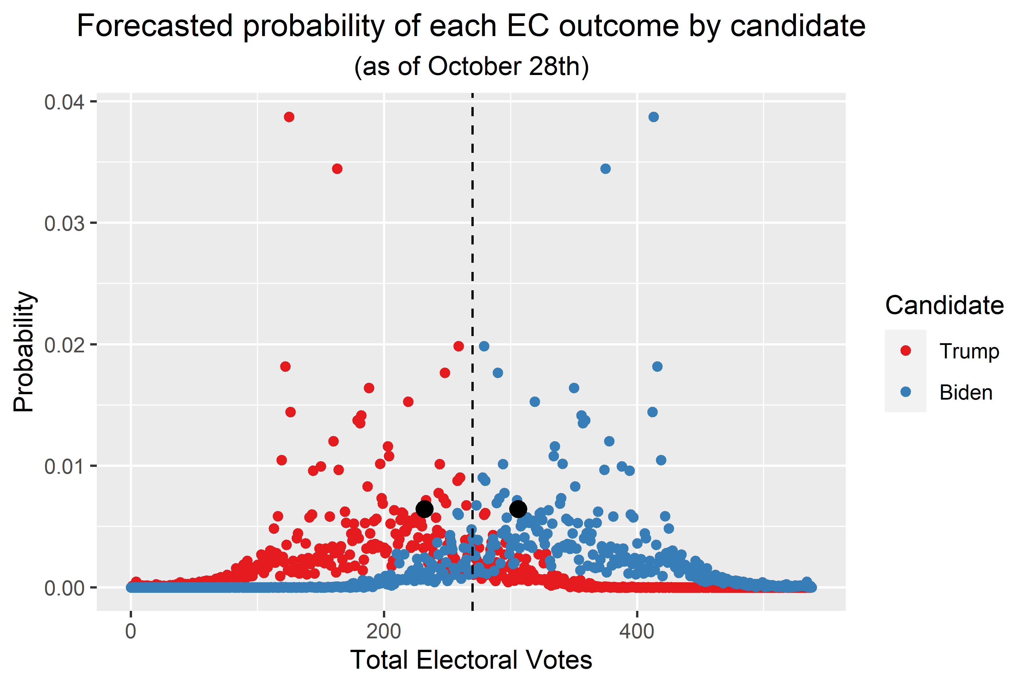
Electoral College Scenarios
Depicts most likely outcome of total electoral votes per candidate
Biden has higher probability in outcomes over 270 electoral votes
However, the EV outcome with the highest assigned probability was 413 EVs for Biden, and 215 EVs for Trump
Actual outcome depicted with the larger, black points
INTRODUCTION | SCENARIOS I STATE | EC | NATIONAL | CONCLUSION​​

Slide 13
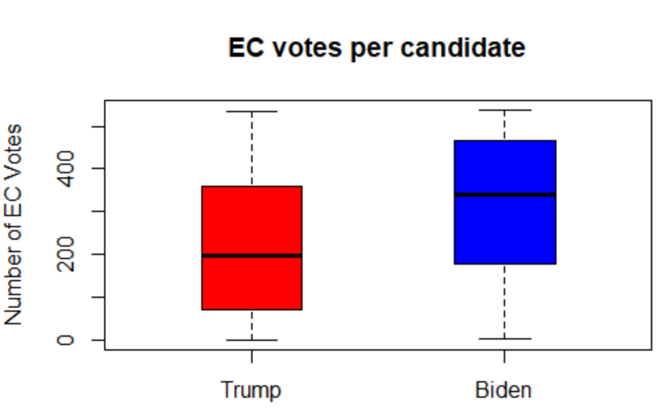
EC Scenario Breakdown
Summary data on Electoral College votes per candidate across 40,000 simulations
Accurately predicts the winner of the election
Fails to predict the Electoral College votes for each candidate
340.46
197.54
INTRODUCTION | SCENARIOS I STATE | EC | NATIONAL | CONCLUSION​​

Slide 14
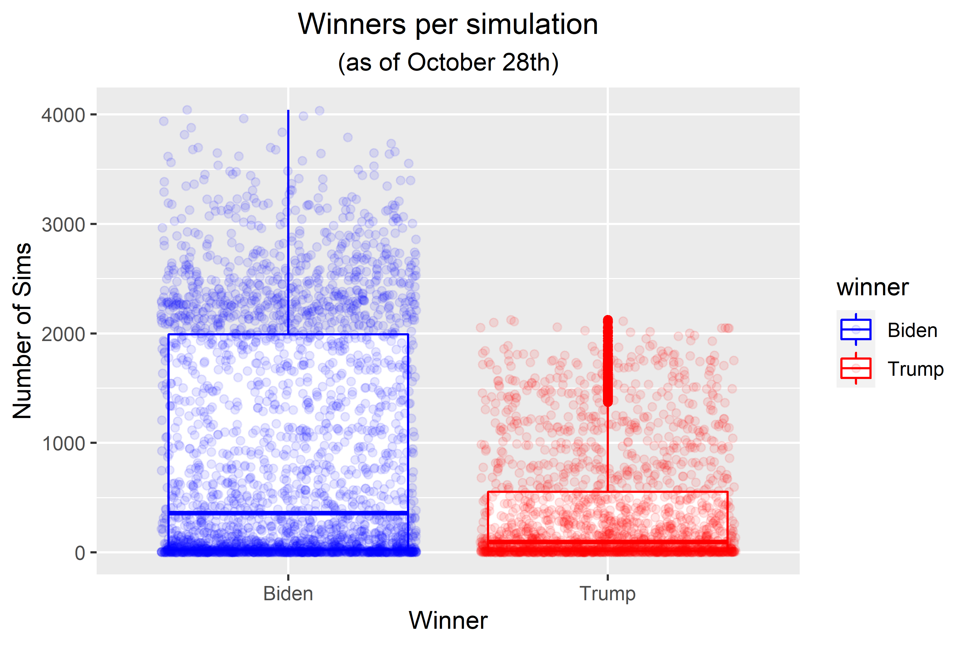
EC Scenario Breakdown
INTRODUCTION | SCENARIOS I STATE | EC | NATIONAL | CONCLUSION​​

Slide 15
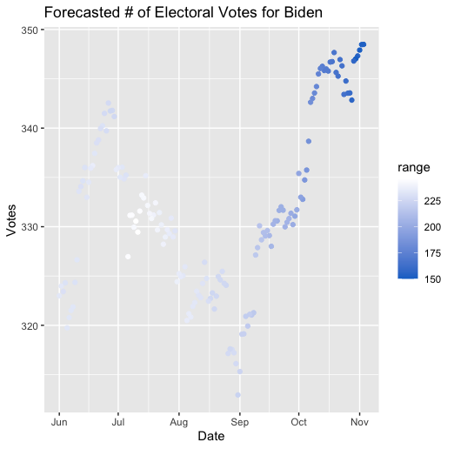
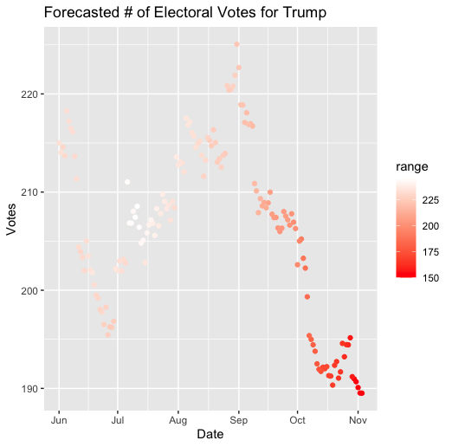
Forecasted Electoral Votes
INTRODUCTION | SCENARIOS I STATE | EC | NATIONAL | CONCLUSION​​

Slide 16
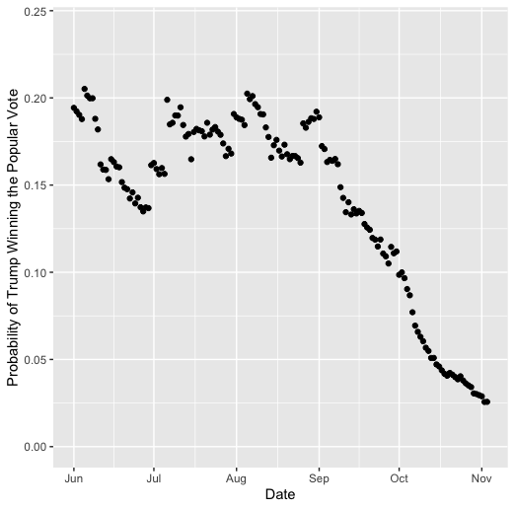
Probability of Trump's Popular Vote
INTRODUCTION | SCENARIOS I STATE | EC | NATIONAL | CONCLUSION​​

Slide 17
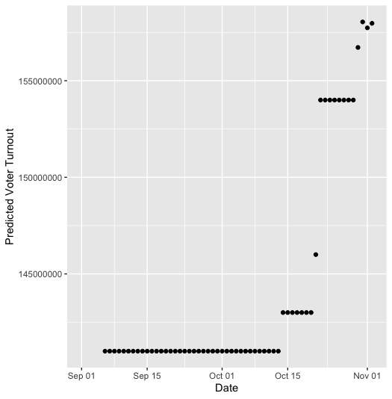
Predicted National Voter Turnout
INTRODUCTION | SCENARIOS I STATE | EC | NATIONAL | CONCLUSION​​

Slide 18
Conclusion: The "Cans" and "Cannots"
The polls can predict who will win the popular vote & electoral college
The polls can't predict the number of electoral college votes each candidate will win
The polls aren't as accurate at predicting swing states outcomes
Election polls can predict the winner given enough data and small confidence intervals
INTRODUCTION | SCENARIOS I STATE | EC | NATIONAL | CONCLUSION​​
Notes:
Arizona and Georgia were also states watched closely this past election

Slide 19

Questions?

